Slide 1

911 calls for service 2020
Phase- III
Presented by: Mumtaz Uddin
Spring 2021

Slide 2
About Data Set
The 911 calls for service 2020 dataset contains Emergency and Non-emergency Police calls to 911 in the Baltimore area and is available through the government website of Baltimore (Baltimore Open Data) that has data for the year 2020.
It has 1.46M rows and 19 columns.
After data cleaning and removing anomalies, the data is approximately 340k rows and 15 columns.

Slide 3

Hypothesis
When to expect more 911 calls and where do these calls come from?
When does the need for police officers/first responders increase/decrease?
Can we schedule their shifts in a more efficient manner?

Slide 4
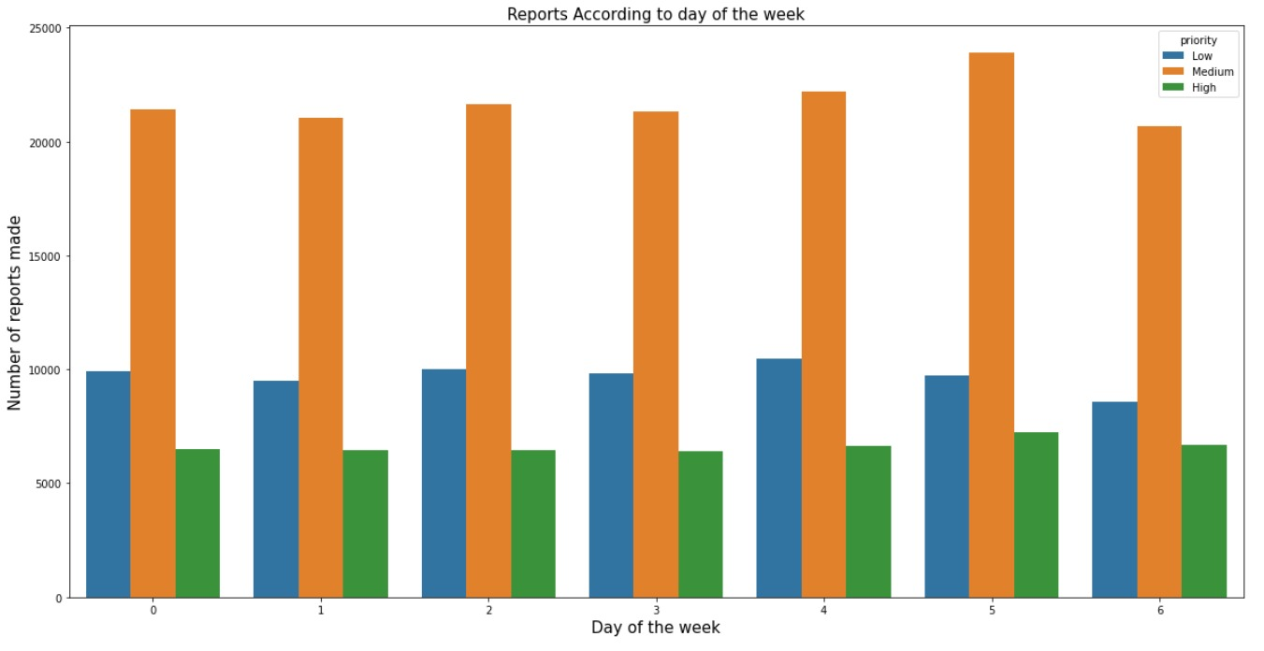
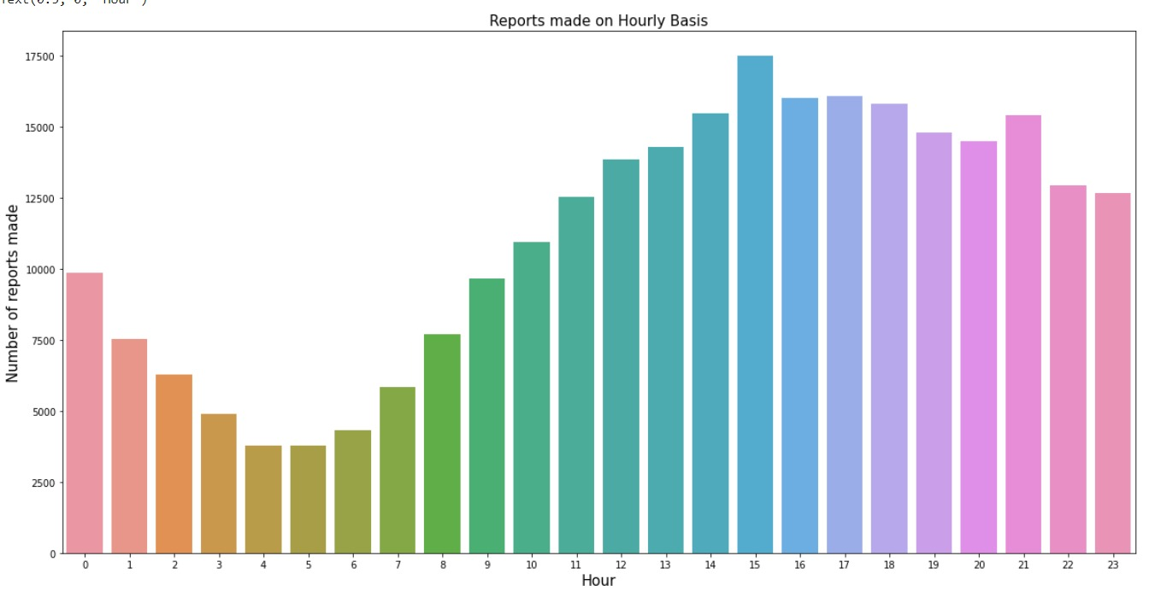
Exploratory data analysis
The following graphs in the reports the number of calls made on hourly basis, and the day of the week which represents the priority as well.
Using the EDA and Time-series analysis we can tell that when to expect more 911 calls and where are these calls coming from.

Slide 5
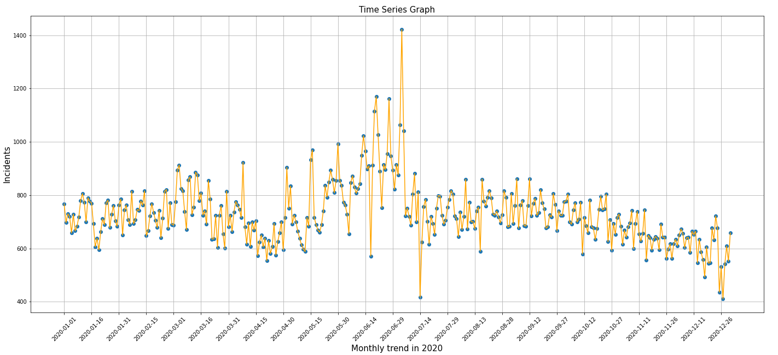
We can see from the time series graph that the first week of July 2020 shows the most incident reported.
Based on the Time-series and EDA of monthly, daily and weekly trend we can interpret when does the need for police officers/first responders increase or decrease.

Slide 6
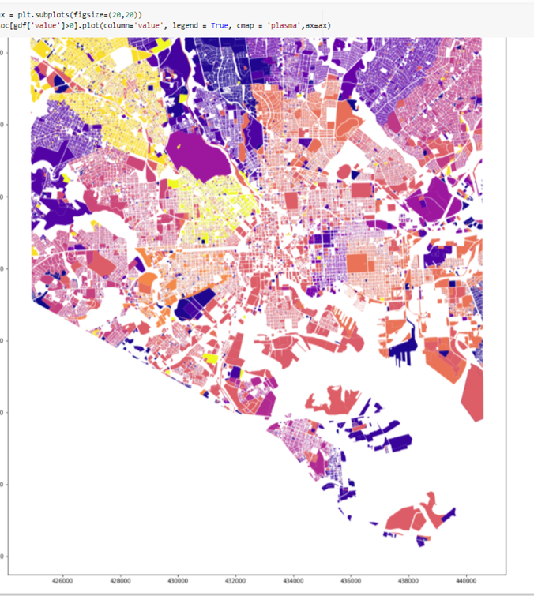
The graphs shows the number of 911 calls based on the geography of the Baltimore area.
Blue shows the range from 0-5000 calls
Violet shows the range from 5000-10000 calls
Pink shows the range from 15000-20000 calls
Orange-Yellow shows the range of 20000+ calls

Slide 7
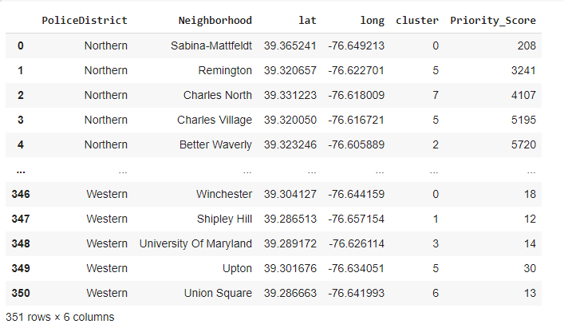
Clustering using K- Means
According to the data there were 9 police districts which had 350 neighborhoods. By using K- Means we were able to determine the priority and to find out how many police officers will be required for every 911 call in an individual neighborhood in a police district

Slide 8
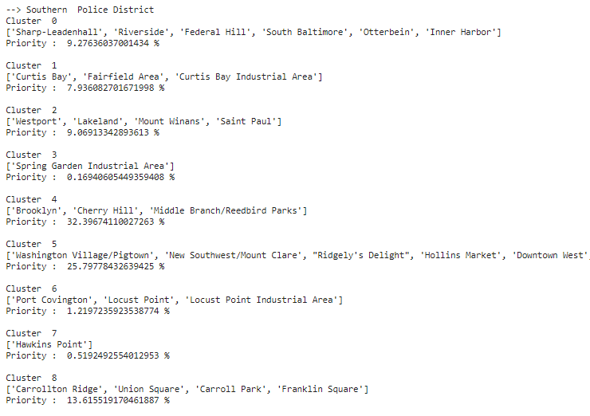
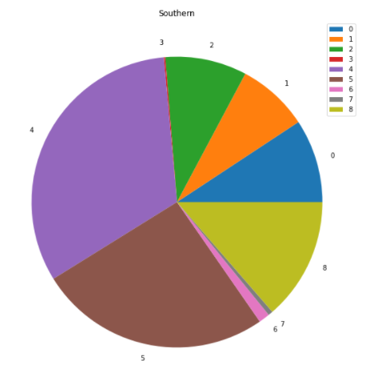
Clustering for Southern District

Slide 9
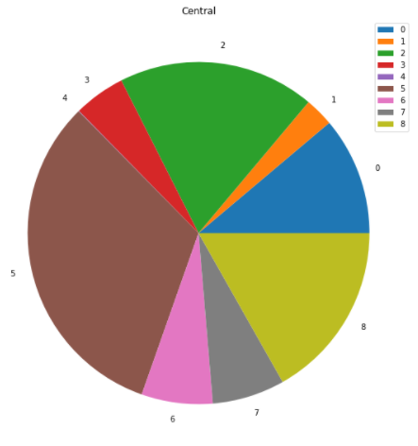
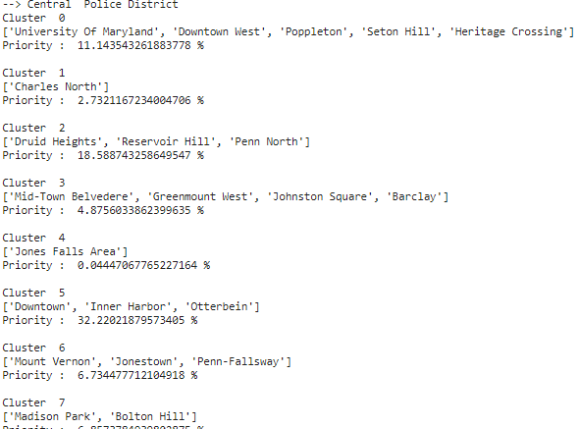
Clustering for Central District: This is an example of one of the districts which represents the division of clusters based on neighborhoods and shows the priority score which tells the number of police officers required at a particular cluster i.e., neighborhood. Using the results, we can schedule their shifts in a more efficient manner and prioritize neighborhood based on historic data.

Slide 10
Conclusion & Future Work
This project helped to gain insights on how 911 emergency system works and helped me in successfully proving all the hypothesis.
Help recognize patterns of 911 calls with respect to time.
Future Work- Creating a scheduling system based on time and predicting risk probabilities by neighborhood.

